Slide 1
C-R-E-A-M
Strategy for Learning

Slide 2
Creativity
“Mixing two different ideas to create a new idea.”

Slide 3
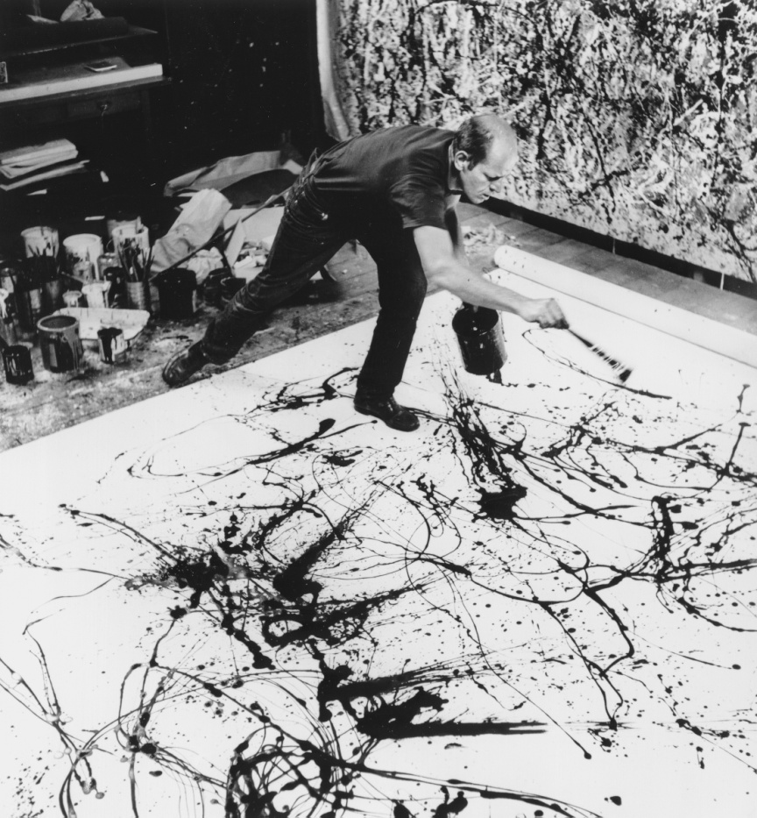
Creative
Have confidence to use individual strategies and styles, applying imagination to your learning.
Creativity is defined by Webster as creative ability or intellectual inventiveness.

Slide 4
Tips to Improve Creativity
Brainstorm can work with an individual or a group.
Alter your focus when faced with a problem you cannot solve.
  Taking a break
  Sleep
  Play
  Value each passing idea. Keep an idea notebook.

Slide 5
Tips to Improve Creativity
Serendipity, the ability to make unlikely and positive discoveries happen by accident, is one manifestation of the sub-conscious mind at work. Cultivating serendipity requires you to keep your eyes open.
Journal your thoughts for future use

Slide 6
Reflective
Be able to sit with your experience, analyze and evaluate your own performance and draw lessons from it.
Jumping to conclusions!!!

Slide 7

Effective
Organize your:
Space
Time
Priorities
State of mind
Resources (including IT)
To maximize benefit.

Slide 8
Effective
Effective study skills must be practiced in order for you to improve.
It is not enough to simply plan for studying.
You have to actually do it, and in the process use information from what you do to get better.

Slide 9

Tips to be Effective Student
The value of a schedule
  Saves Time
  Making every hour count
When to study

Slide 10

Active Learner
Be personally involved and get moving.
Have your own vision and then strive to make it happen.

Slide 11

Motivated
How can we enjoy studying?
What can we do to make this fun and enriching?
How is learning real for us?

Slide 12
QUESTS
Ideas have created more wealth OR the wealth has created more ideas?

Slide 13
2
Can anyone waste someone ELSE’s time?

Slide 14
3
Development is a ‘journey’ OR a ‘destination’?

